Slide 1
MALLA REDDY UNIVERSITY
MR22-1CS0141:
DESIGN AND ANALYSIS OF ALGORITHMS
II YEAR B.TECH. (CSE) / I - SEM
(MRU - R22)
UNIT-IV

Slide 2
UNIT- IV
Dynamic Programming:
General method of Dynamic Programming- Principle of Optimality
Applications of Dynamic Programming
0/1 Knapsack problem: Set method - Tabulation method,
All pairs shortest path problem: Floyd Warshall Algorithm, Traveling sales person problem, Matrix chained multiplication.

Slide 3
Dynamic Programming
A technique that breaks the problems into sub-problems, and saves the result for future purposes to avoid repetitive computations.
dynamic programming is to solve optimization problems.
optimization problems means that to find out the minimum or the maximum solution of a problem.
Example: Fibonacci series,
0, 1, 1, 2, 3, 5, 8, 13, 21, 34, 55, 89, 144, ,…
With the base values F(0) = 0, and F(1) = 1,
F(n) = F(n-2) + F(n-1)

Slide 4
Dynamic Programming
The following are the steps that the dynamic programming follows:
It breaks down the complex problem into simpler subproblems.
It finds the optimal solution to these sub-problems.
It stores the results of subproblems.
The process of storing the results of subproblems is known as memorization.
It reuses them so that same sub-problem is calculated more than once.
Finally, calculate the result of the complex problem.

Slide 5
Approaches of dynamic programming
There are two approaches to dynamic programming:
Top-down approach –
follows the memorization technique
memorization is equal to the sum of recursion and caching
Bottom-up approach –
follows the tabulation method
it removes the recursion
Advantages
It is very easy to understand and implement.
It solves the sub problems only when it is required.
It is easy to debug.
Disadvantages
It uses the recursion technique that occupies more memory in the call stack.
Sometimes when the recursion is too deep, the stack overflow condition will occur.
It occupies more memory that degrades the overall performance.

Slide 6
Fibonacci series- Recursive function
Recurrence Relation:
T(n)=2T(n-1)+1
Time complexity: O(2^{n})
int fib(int n) { if (n>=0) { if(n==0) return 0; if(n==1) return 1; sum = fib(n-1) + fib(n-2); } }
fib(4)
fib(2)
fib(3)
fib(0)
fib(1)
fib(1)
fib(2)
fib(0)
fib(1)

Slide 7
Recursion (Top-down Approach)
Applying dynamic programming:
Create a Global array to store the results.
Initially,
After computation,
fib(4)
0 | 1 | 2 | 3 | 4
-1 | -1 | -1 | -1 | -1
fib(2)
fib(3)
0 | 1 | 2 | 3 | 4
0 | 1 | -1 | -1 | -1
fib(0)
fib(1)
fib(1)
fib(2)
0 | 1 | 2 | 3 | 4
0 | 1 | 1 | -1 | -1
fib(0)
fib(1)
0 | 1 | 2 | 3 | 4
0 | 1 | 1 | 2 | 3

Slide 8
Recursion (Top-down Approach)
By following Memorization,
Fib(n)=n+1 calls
= O(n)
fib(4)
fib(2)
fib(3)
fib(0)
fib(1)
fib(1)
fib(2)
fib(0)
fib(1)

Slide 9
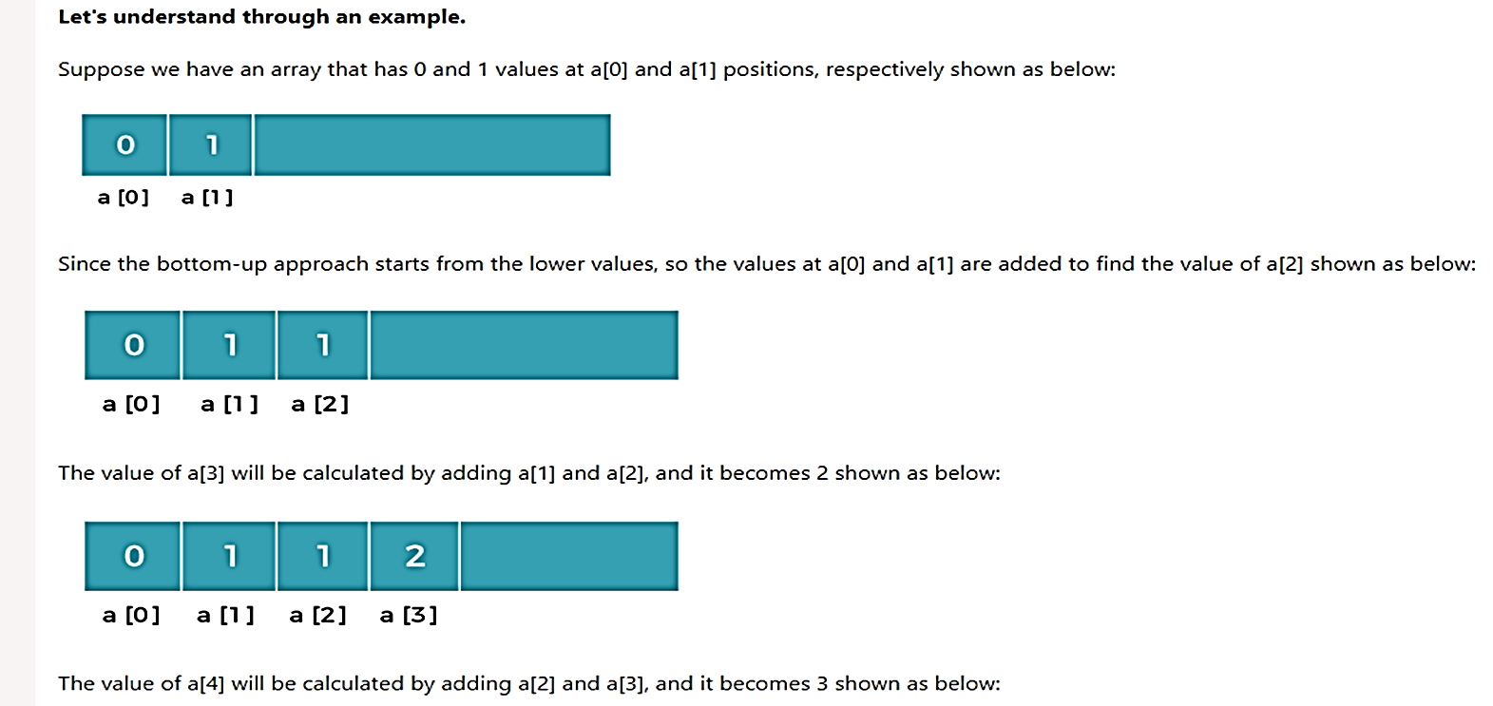
Recursion (Bottom-up Approach)

Slide 10
Iterative method (Bottom-up approach)
By using Tabulation method,
Time Complexity = O(n)
int fib(int n) { int fib, num1 = 0, num2 = 1; for (int i = 1; i < n; i++) { fib= num1; num1 = num2; num2 = fib + num1; } return num2; }
0 | 1 | 2 | 3 | 4 | 5
0 | 1 | 1 | 2 | 3 | 5

Slide 11
Applications of Dynamic Programming
0/1 Knapsack problem
All pairs shortest path problem
Traveling sales person problem
Matrix chained multiplication
Optimal binary search trees
Reliability design

Slide 12
0/1 Knapsack problem
We are given n objects and a knapsack.
Each object i has a positive weight w_{i} and a positive value V_{i}.
The knapsack can carry a weight not exceeding W.
Fill the knapsack so that the value of objects in the knapsack is optimized.
A solution to the knapsack problem can be obtained by making a sequence of decisions on the variables x₁, x₂, . . . . , x_{n}.
A decision on variable x_{i} involves determining which of the values 0 or 1 is to be assigned to it.
Let us assume that decisions on the x_{i} are made in the order x_{n}, x_{n-1}, x₁.
Following a decision on x_{n}, we may be in one of two possible states:
the capacity remaining in m – w_{n} and a profit of p_{n} has accrued.
Otherwise, xn, , x1 will not be optimal.
V[i,w] = max {V[i-1,w] , V[i-1, w-w[i]] + p[i]}

Slide 13
0/1 Knapsack problem
Example 1:
Consider the problem having weights and profits are
Weights : {2, 3, 4, 5}
Profits : {1, 2, 5, 6}
The weight of the knapsack is, m = 8 kg
The number of items is, n = 4
To find all the solutions, it takes 2^{n} times. So the complexity is O(2^{n})
By tabulation method,

Slide 14
0/1 Knapsack problem
Initially, the first row and first column would be 0 as there is no item for w=0.
When i=1,

Slide 15
0/1 Knapsack problem
When i=2,
When i=3,

Slide 16
0/1 Knapsack problem
When i=4,
x₁, x₂, x₃, x₄ = {0, 1, 0, 1}

Slide 17
0/1 Knapsack problem
Example 2:
Consider the problem having weights and profits are
Weights : {3, 4, 6, 5}
Profits : {2, 3, 1, 4}
The weight of the knapsack is, m = 8 kg
The number of items is, n = 4
To find all the solutions, it takes 2^{n} times. So the complexity is O(2^{n})
By tabulation method,
Initially, the first row and first column would be 0 as there is no item for w=0.
V
0
1
2
3
4
5
6
7
8
p
w
i
i
0
0
0
0
0
0
0
0
0
0
2
3
1
0
3
4
2
0
4
5
4
0
1
6
3
0

Slide 18
0/1 Knapsack problem
When i=4,
x₁, x₂, x₃, x₄ = {1, 0, 0, 1}
V
0
1
2
3
4
5
6
7
8
p
w
i
i
0
0
0
0
0
0
0
0
0
0
2
3
1
0
0
0
2
2
2
2
2
2
3
4
2
0
0
0
2
3
3
3
5
5
4
5
4
0
0
0
2
3
4
4
5
6
1
6
3
0
0
0
2
3
4
4
5
6

Slide 19
All Pairs Shortest Path Problem
It is an algorithm for finding the shortest path between all the pairs of vertices in a given edge-weighted directed Graph.
This algorithm follows the dynamic programming approach to find the shortest path.
The Floyd-Warshall Algorithm is for solving all pairs of shortest-path problems.
Steps to solve:
Consider a given graph, G
Construct a Matrix for the given graph G by the following ways,
Cost of the graph is cost of each edges and cost(i,i)=0
If there is an edge between i and j then cost(i,j)=cost of the edge from i to j
If there is no edge then cost(i,j) = ∞
Calculate the shortest path between any two vertices using intermediary vertex.
The minimum cost can be calculated using the formula,
A^{k} [i, j] = min{ A^{k – 1} [i, j], A^{k – 1} [i, k] + A^{k – 1} [k, j] }

Slide 20

All Pairs Shortest Path Problem
Algorithm FLOYD_APSP ( L)
// L is the matrix of size n X n representing original graph
// A is the distance matrix
A ← L
for k ← 1 to n do
for i ← 1 to n do
for j ← 1 to n do
A^{k} [i, j] ← min{ A^{k – 1} [i, j], A^{k – 1} [i, k] + A^{k – 1} [k, j] }
end
end
end
return A
The running time of the algorithm is computed as :

Slide 21

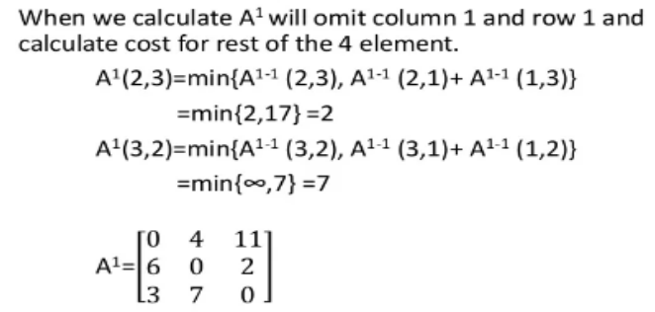
All Pairs Shortest Path Problem
Example 1:
6
1
2
4
11
3
2
3

Slide 22
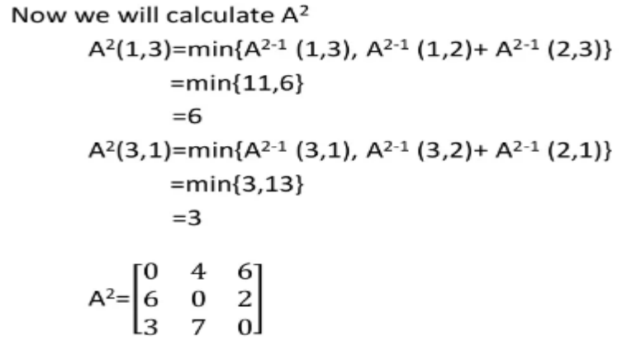
All Pairs Shortest Path Poblem

Slide 23
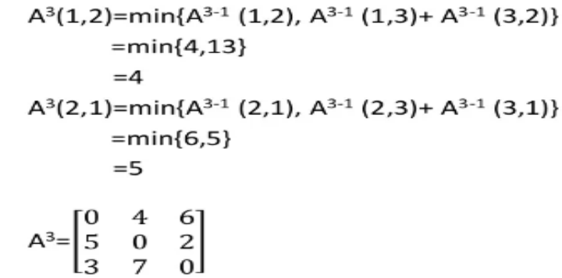
All Pairs Shortest Path Problem
Now we will calculate A³

Slide 24
All Pairs Shortest Path Problem
Example 2: Solution:
8
1
2
3
7
5
2
2
4
3
1

Slide 25
All Pairs Shortest Path Problem
Example 3: Solution:
1
4
8
1
4
2
2
9
1
3

Slide 26
Traveling Sales Person Problem
The travelling salesman problem is a graph computational problem.
Given a set of cities and the distance between every pair of cities, the problem is to find the shortest possible route that visits every city exactly once and returns to the starting point.
The salesman needs to visit all cities (represented using nodes in a graph) in a list just once and the distances (represented using edges in the graph) between all these cities are known.
The solution that is needed to be found for this problem is the shortest possible route in which the salesman visits all the cities and returns to the origin city.

Slide 27
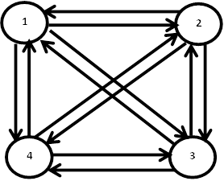
Traveling Sales Person Problem
Example 1:
For the following graph find minimum cost tour for the traveling salesperson problem.
The cost of adjacency matrix =

Slide 28
Traveling Sales Person Problem
15+25=40
Optimal Solution
20+23=43
12+13=25
10+15=25
8+15=23
9+6=15
13+5=18
8+5=13
8
6
8
5
6
5

Slide 29
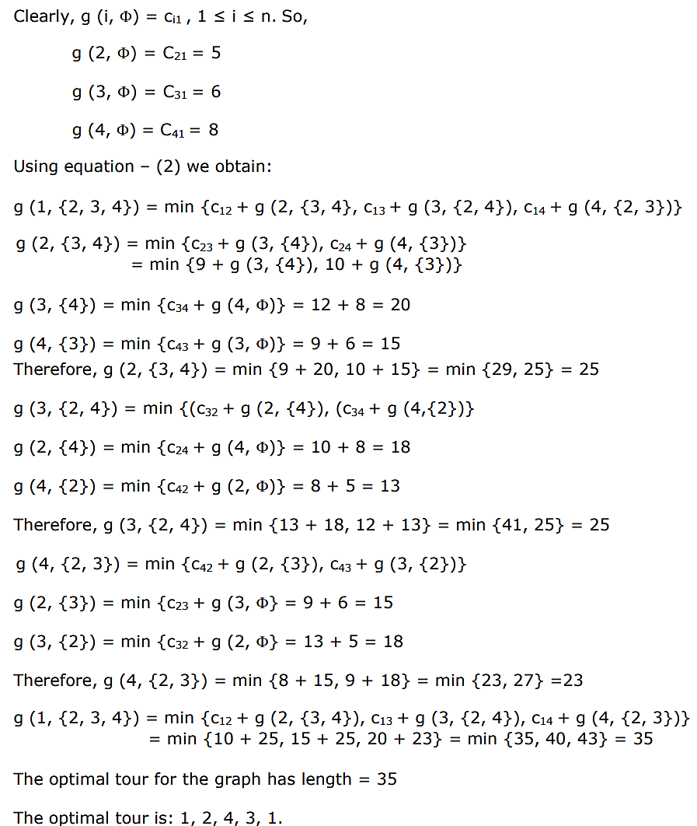

Slide 30
Traveling Sales Person Problem
Algorithm:
g(i,i)=0
for s=2 to n do
For all subsets S € {1,2,3,….,n} of size s and containing l
C(S,l) = ∞
For all i,j € S and j ≠ l and i ≠ j
g(i,S)= min { c(i,j) + g(j, {S-j})}
Return g(i,S)
Time Complexity : O(n² * 2^{n})
where O(n * 2^{n}) are maximum number of unique subproblems / states and O(n) for transition (through for loop as in code) in every states.

Slide 31
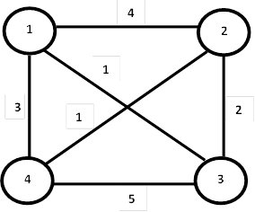
Traveling Sales Person Problem
Example 2:
For the following graph find minimum cost tour for the traveling salesperson problem.
The cost of adjacency matrix =

Slide 32
Traveling Sales Person Problem
Optimal Solution
1+6=7
3+4=7
1+6=7
5+5=10
1+3=4
1+4=5
2+1=3
2+4=6
3
1
3
4
1
4

Slide 33
Matrix chained multiplication
The problem:
Given a sequence of matrices A1, A2, A3, ..., An.
Find the best way (using the minimal number of multiplications) to compute their product.
Matrix multiplication is associative.
E.g.:
((· · · ((A1 · A2 ) · A3 )· · ·) · An)
A1 · (A2 · (A3 · (· · · (An−1 · An )· · ·))) yields the same matrix.
Different multiplication orders do not cost the same:
Multiplying p × q matrix A and q × r matrix B takes p · q · r multiplications;
result is a p × r matrix.
Consider multiplying 10 × 100 matrix A1 with 100 × 5 matrix A2 and 5 ×50 matrix A3.
(A1 · A2) · A3 takes 10 · 100 · 5 + 10 · 5 · 50 = 7500 multiplications.
A1 · (A2 · A3) takes 100 · 5 · 50 + 10 · 50 · 100 = 75000 multiplications.

Slide 34
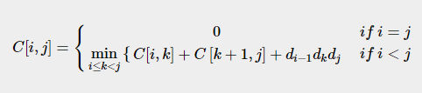

Matrix chained multiplication
Using the formula,
Find the lowest cost parenthesization of the sequence of matrices by constructing cost tables and corresponding k values table.

Slide 35


Matrix chained multiplication
Example:
A sequence of matrices A, B, C, D with dimensions 5 × 10, 10 × 15, 15 × 20, 20 × 25 are set to be multiplied. Find the lowest cost parenthesization to multiply the given matrices using matrix chain multiplication.
Solution:
Given matrices and their corresponding dimensions are ,
Find the count of parenthesization of the 4 matrices, i.e. n = 4.
Since n = 4 ≥ 2, apply the second case of the formula,

Slide 36

Matrix chained multiplication
P(1) = 1
P(2) = P(1)P(1) = 1
P(3) = P(1)P(2) + P(2)P(1)
= 1 + 1
= 2
P(4) = P(1)P(3) + P(2)P(2) + P(3)P(1)
= 2 + 1 + 2
= 5
Among these 5 combinations of parenthesis, the matrix chain multiplicatiion algorithm must find the lowest cost parenthesis.

Slide 37
Matrix chained multiplication
Step 1:
The table below is known as a cost table, where all the cost values calculated from the different combinations of parenthesis are stored.
Another table is also created to store the k values obtained at the minimum cost of each combination.

Slide 38
Matrix chained multiplication
Step 2:
Applying the dynamic programming approach formula find the costs of various parenthesizations,
C[1,1]=0
C[2,2]=0
C[3,3]=0
C[4,4]=0

Slide 39
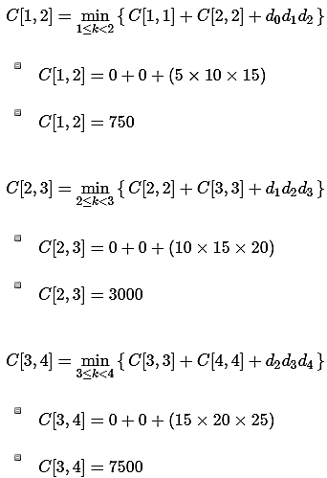
Step 3:
Applying the dynamic approach formula only in the upper triangular values of the cost table, since i < j always.

Slide 40
Matrix chained multiplication

Slide 41
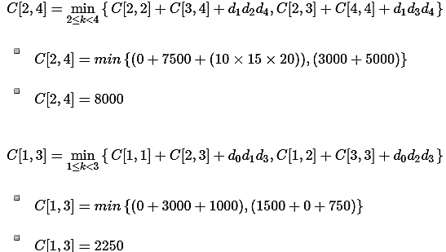
Matrix chained multiplication
Step 4:
Find the values of [1, 3] and [2, 4] in this step. The cost table is always filled diagonally step-wise.

Slide 42
Matrix chained multiplication

Slide 43
Matrix chained multiplication
Step 5:
Now compute the final element of the cost table to compare the lowest cost parenthesization.
C[1,4]= min { C[1,1] +C[2,4]+d₀d₁d₄, C[1,2] +C[3,4]+d₀d₂d₄, C[1,3] +C[4,4]+d₀d₃d₄ }
1≤k<4
C[1,4]=min{0 + 8000 + 1250, 750 + 7500 + 1875, 2250 + 0 + 2500}
C[1,4]=4750

Slide 44
Matrix chained multiplication
Now that all the values in cost table are computed, the final step is to parethesize the sequence of matrices. For that, k table needs to be constructed with the minimum value of ‘k’ corresponding to every parenthesis.

Slide 45
Matrix chained multiplication
Parenthesization:
Based on the lowest cost values from the cost table and their corresponding k values, let us add parenthesis on the sequence of matrices.
The lowest cost value at [1, 4] is achieved when k = 3, therefore, the first parenthesization must be done at 3.
(ABC)(D)
The lowest cost value at [1, 3] is achieved when k = 2, therefore the next parenthesization is done at 2.
((AB)C)(D)
The lowest cost value at [1, 2] is achieved when k = 1, therefore the next parenthesization is done at 1.
But the parenthesization needs at least two matrices to be multiplied so we do not divide further.
((AB)(C))(D)
Since, the sequence cannot be parenthesized further, the final solution of matrix chain multiplication is ((AB)C)(D).

